Slide 1

Fakultas Ilmu Komputer
Learning is the process of acquiring new understanding, knowledge, behaviors, skills, values, attitudes, and preferences.
Framework #6
[Bootstrap & JQuery]

Slide 2

Welcome to the Framework Programming course

Slide 3

Front-End Web Developer
Seorang Front-End Web Developer adalah Software Developer yang bertanggung jawab untuk merancang dan membangun berbagai aplikasi web secara responsif, interaktif, dan juga user friendly. Seorang Front-End Web Developer memiliki peranan besar dalam pengembangan aplikasi web karena bertanggung jawab langsung kepada pengalaman pengguna.
Read Source:
https://www.dicoding.com/learningpaths/22/

Slide 4
Front-End Web Development
Developer memegang peranan penting di dalam pengembangan sebuah situs atau aplikasi. Apakah perbedaan front end dan back end?
Front-end & Back-end Developer :
Front end developer adalah orang yang berperan mengembangkan tampilan situs atau aplikasi melalui HTML, CSS, dan JavaScript. Sedangkan, back end developer adalah orang yang berperan agar situs atau aplikasi dapat bekerja.
https://glints.com/id/lowongan/perbedaan-front-end-dan-back-end/

Slide 5
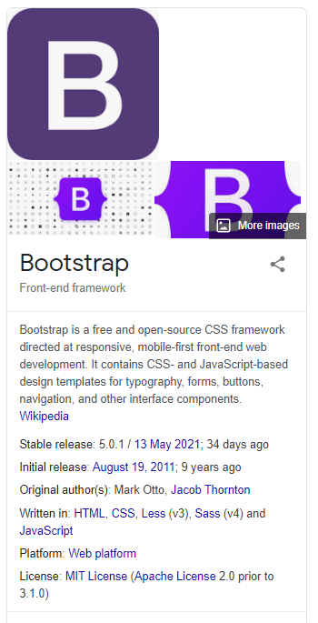
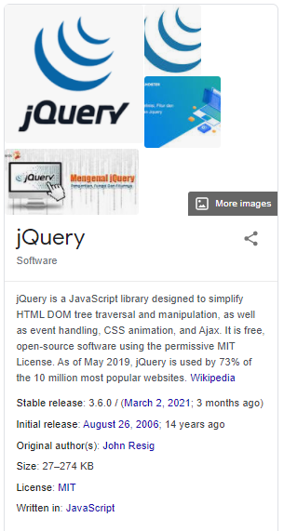

Bootstrap & JQuery
Bootstrap is a free and open-source CSS framework directed at responsive, mobile-first front-end web development. jQuery is a JavaScript library designed to simplify HTML DOM tree traversal and manipulation, as well as event handling, CSS animation, and Ajax.
How to download Bootstrap and JQuery and add/use them offline in the project?

Slide 6
File/Directory Framework Structure
No | Directory/File | Description (optional)
1 | app | app directory is the web application’s private directory of this new framework.
2 | public | public directory is to store all the public static resources like html, css, image and js files.
3 | core | core directory is to store all files for routing and it will store the framework’s core classes.
4 | model | model directory is for all app’s Model classes.
5 | view | view directory is for all app’s View classes.
6 | controller | controller directory is for all app’s Controller classes.
7 | css | css directory is for Cascading Style Sheets (CSS) files.
8 | img | Img directory is for images files.
9 | js | js directory is for Javascript files.
10 | index.php | index.php file is the “entry-point” file, the front controller to the users.
Additional Directories:
template directory stores the template files like header file and footer file.
config directory stores the app’s configuration files.
upload directory is for uploaded files, such as uploaded images.
db directory is database related classes, such as database driver classes.
helper directory is help/assistant functions.
library directory is for class libraries.

Slide 7
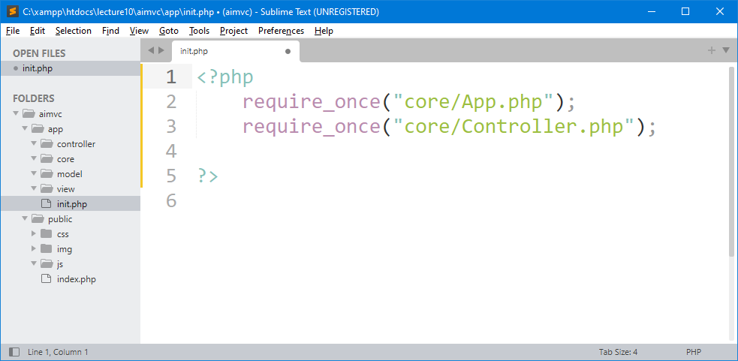

MVC Assets Directory
The assets directory is more like a files system and provides more freedom to put any file you would like in the directory. Here, we used Public Directory as a assets directory which store some public static resources like css, image and js files. The public directory contains the index.php file, which is the entry point for all requests entering the application and configures autoloading. This directory also houses the assets such as images, JavaScript, and CSS.

Slide 8
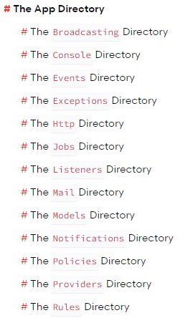
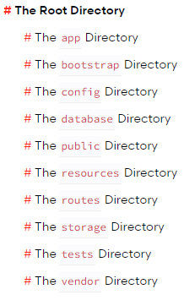
Laravel Directory Structure
Read Source:
https://laravel.com/docs/8.x/structure/

Slide 9

1 – Create URL Path Constants

Slide 10
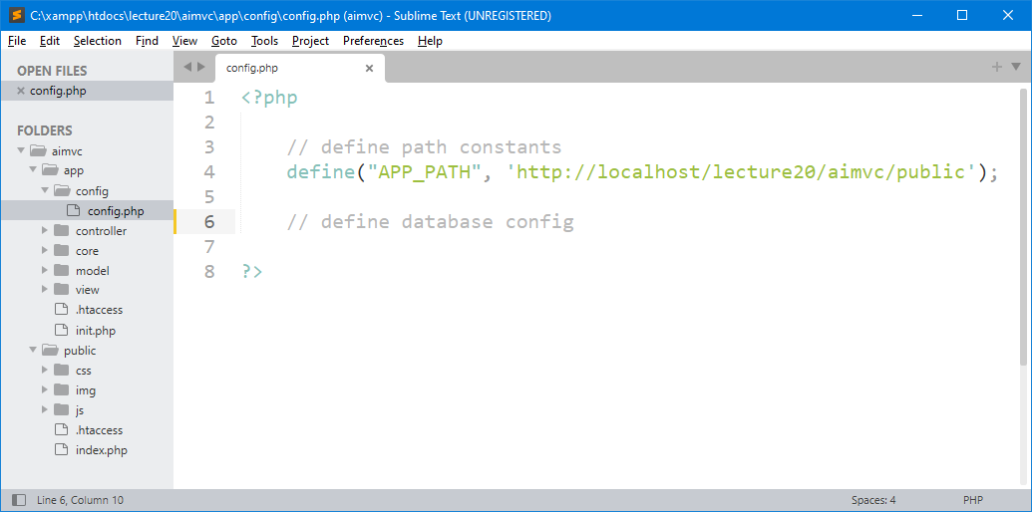
1 – Create config File & Directory
Define new path constants with the value is the your base URL. Remember, if you change the current working directory name, you may need to rename also in this config file.

Slide 11
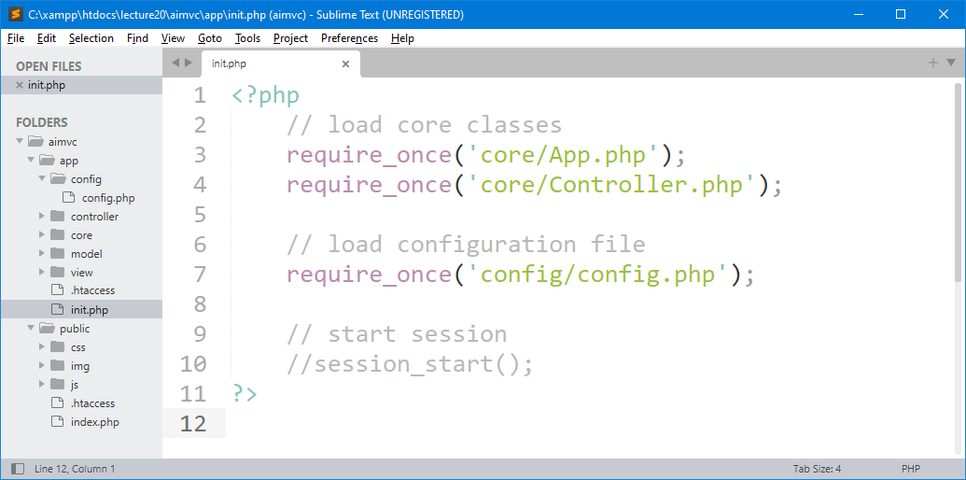
2 – Initialize Config File as a the Core

Slide 12
2 – Download Bootstrap and Put in Public/Assets Directory

Slide 13
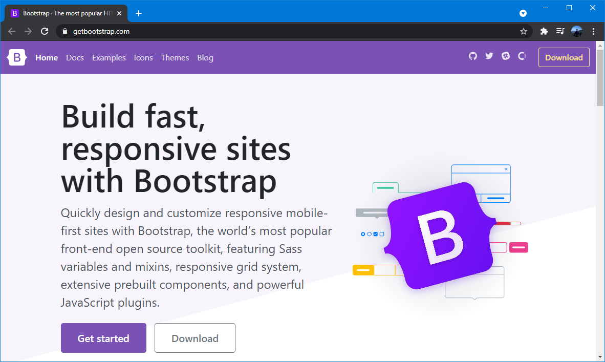
1 - Download Bootstrap
Visit Bootstrap from Bootstrap official website. Link: https://getbootstrap.com/

Slide 14
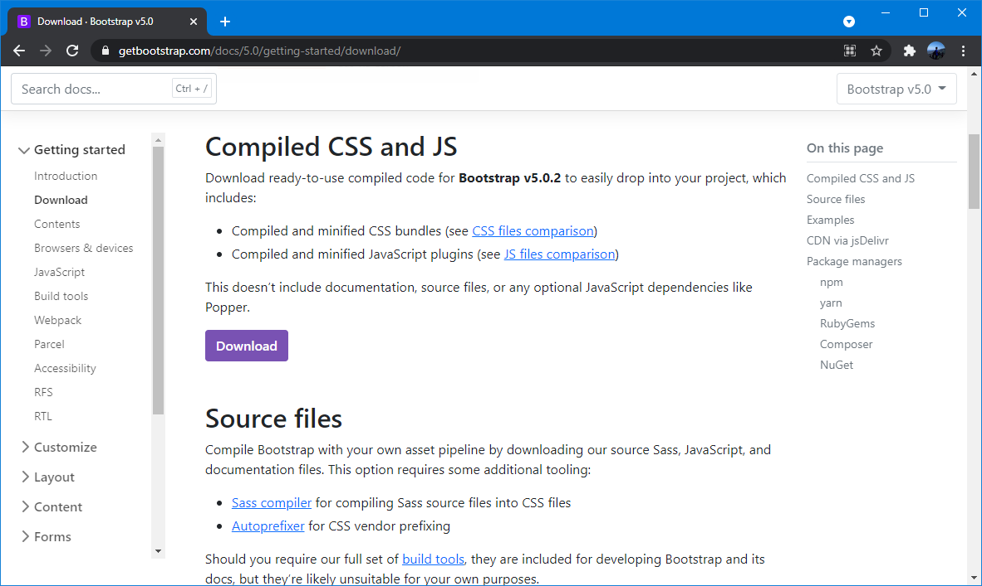
2 - Download Bootstrap
Download ready-to-use compiled code for Bootstrap v5.0.2 to easily drop into your project.
Link: https://getbootstrap.com/docs/5.0/getting-started/download/

Slide 15
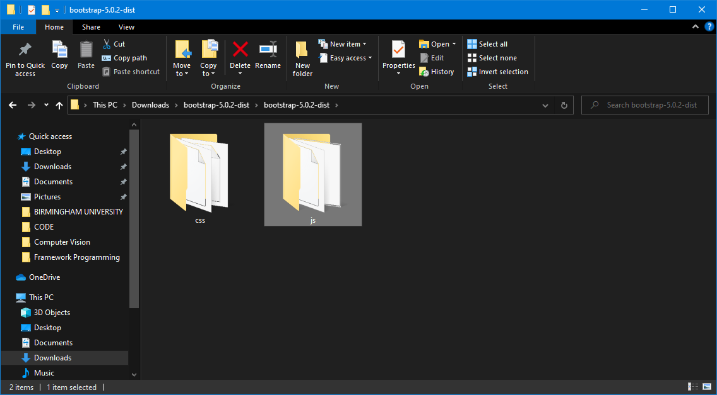
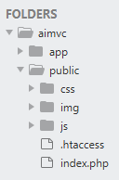
3 - Extract Bootstrap & Place them in Project
Copy and paste these two folders in our public/assets directory, if the directory already existed, you can paste and replace both directories.

Slide 16
2 – Download jQuery and Put in Public/Assets Directory

Slide 17
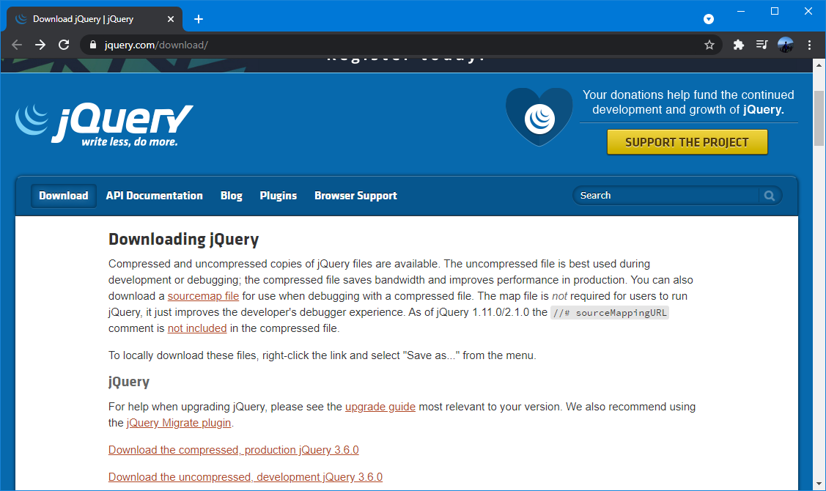
1 - Download jQuery
Visit jQuery from jQuery official website. Link: https://jquery.com/download/

Slide 18
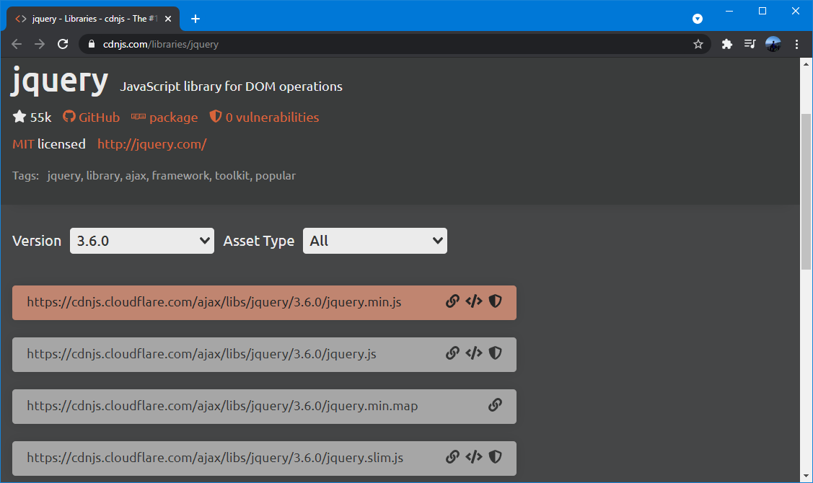
2 - Download jQuery.slim.min.js
Visit jQuery from jQuery official website. Link: https://cdnjs.com/libraries/jquery/
https://code.jquery.com/jquery-3.3.1.slim.min.js

Slide 19
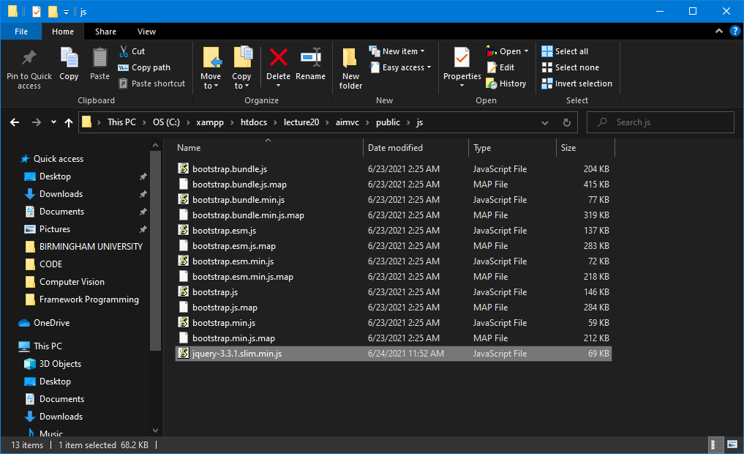
3 – Save to your Working Directory

Slide 20
Does bootstrap 5 require jQuery?
Bootstrap 5 is designed to be used without jQuery, but it's still possible to use our components with jQuery.
Bootstrap uses jQuery for JavaScript plugins (like modals, tooltips, etc). However, if you just use the CSS part of Bootstrap, you don't need jQuery.

Slide 21
3 – Quick start to add Bootstrap & jQuery to Project

Slide 22
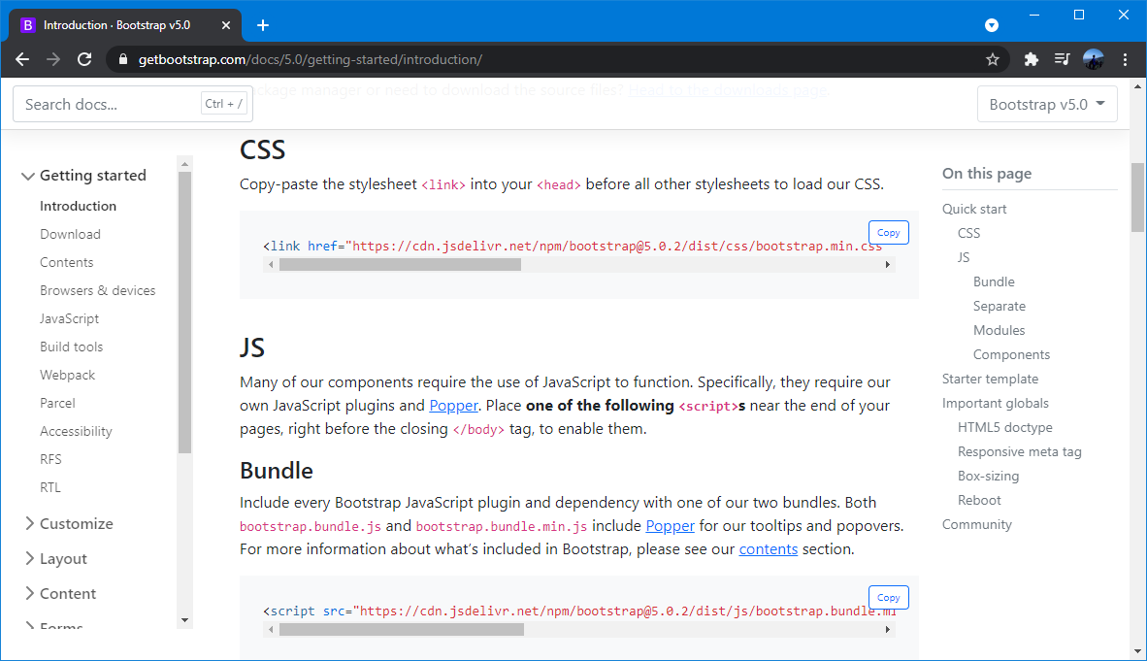
1 - Get started with Bootstrap
Link: https://getbootstrap.com/docs/5.0/getting-started/introduction/

Slide 23
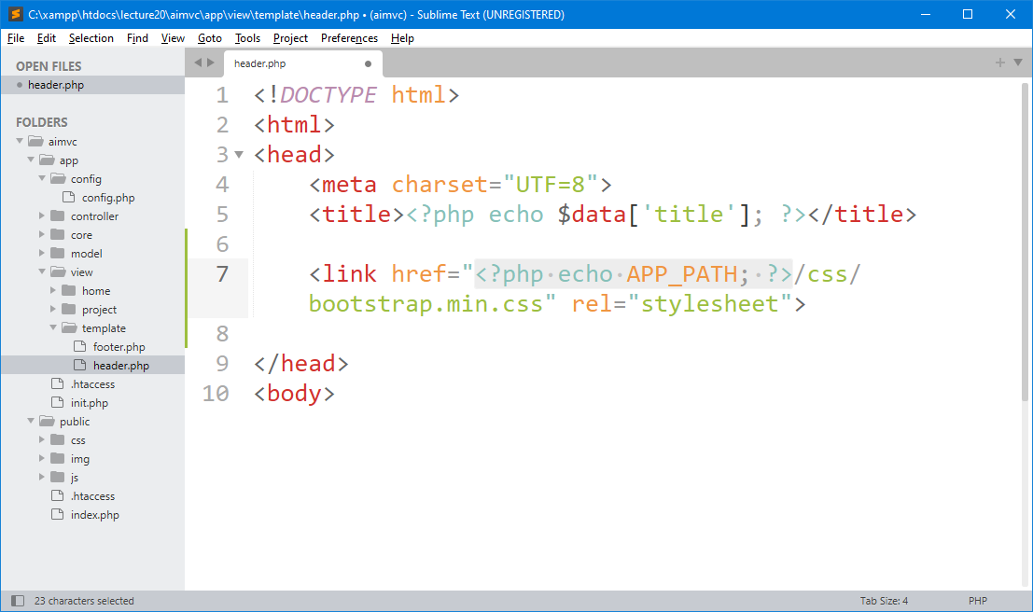
2 – Place Bootstrap in our Project (Offline)

Slide 24
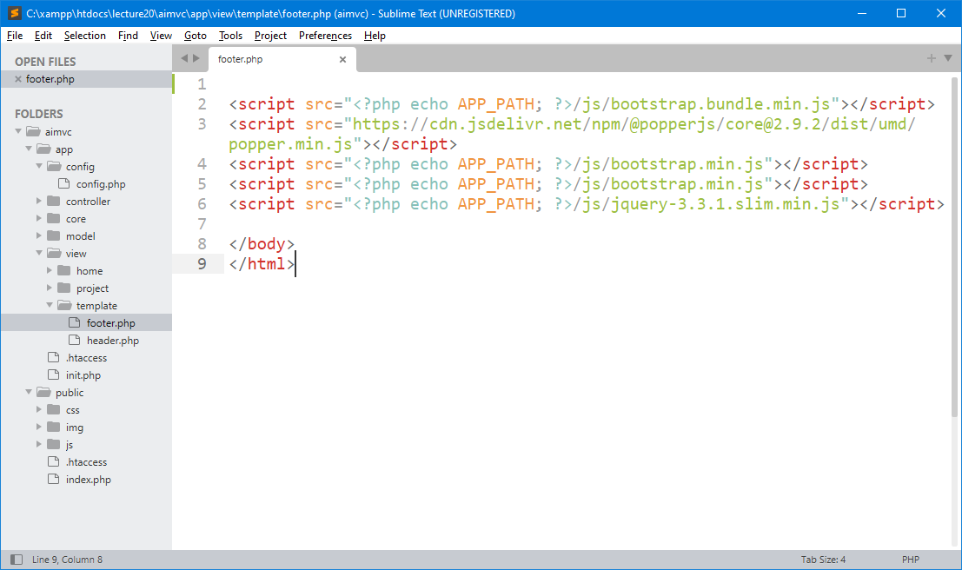
3 – Place JavaScript in our Project

Slide 25
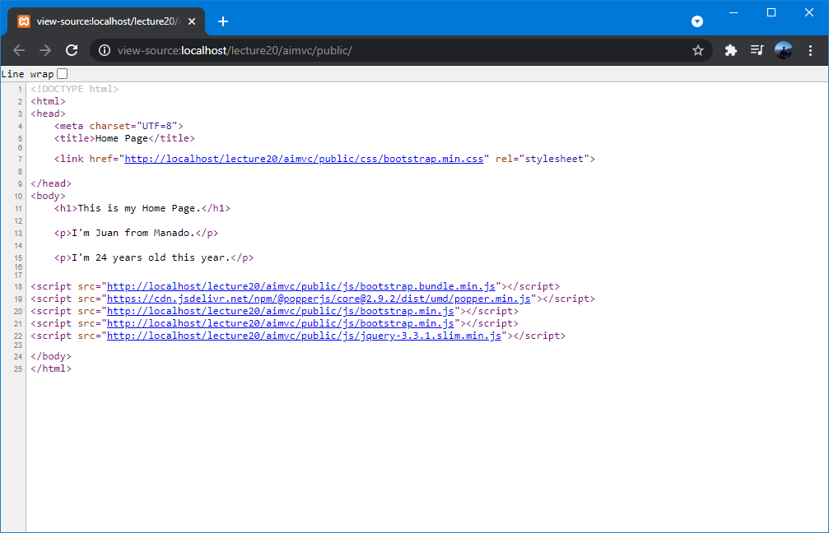
4 – Testing
Open the project in the browser. Right-click on the page and click “view page source”, when the source page opens, you'll see the HTML code for the full page.

Slide 26
4 – Create a Simple Bootstrap Page with navigation header (Navbar)

Slide 27
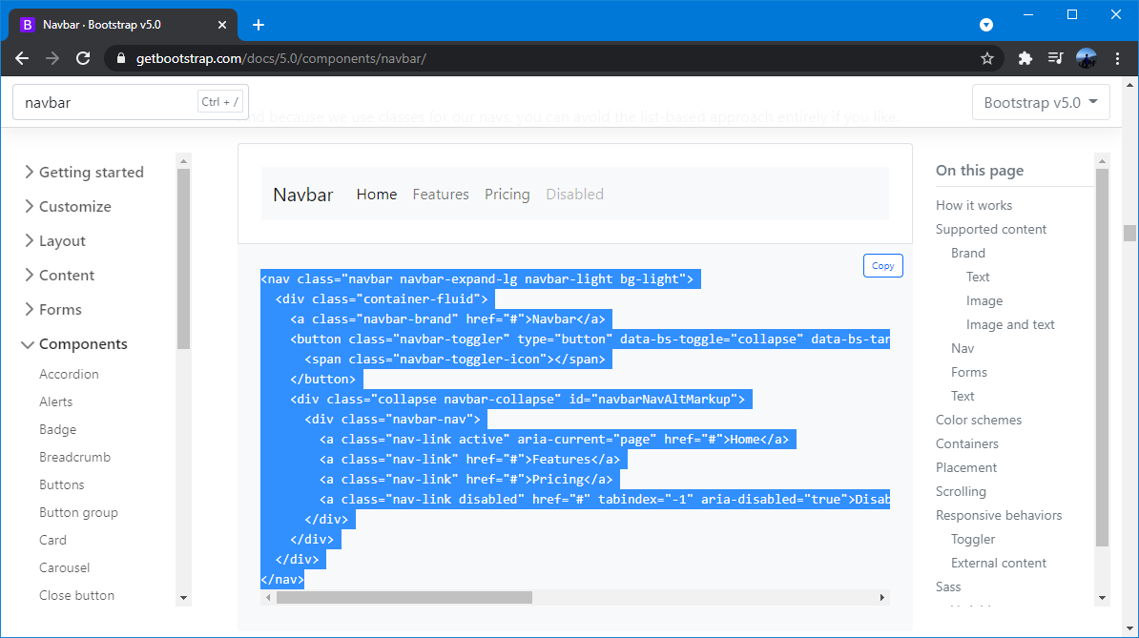
1 – Find Example Navbar in Bootstrap
Copy this code.
In column search, you can find Navbar or follow this link:
Link: https://getbootstrap.com/docs/5.0/components/navbar/

Slide 28
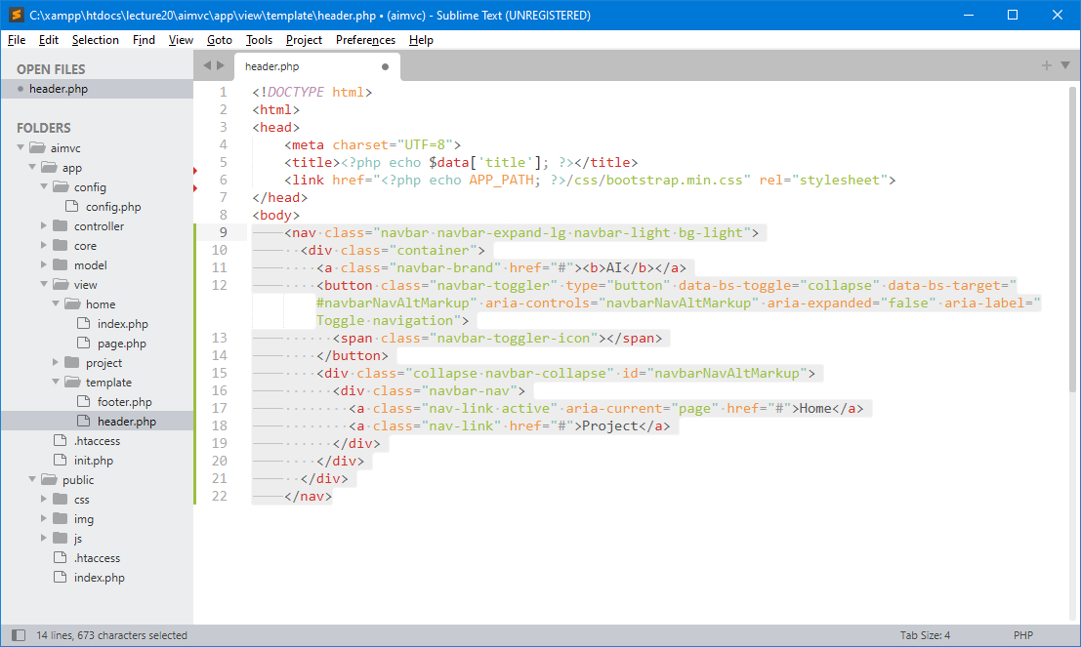
2 – Add Navbar in header.php

Slide 29
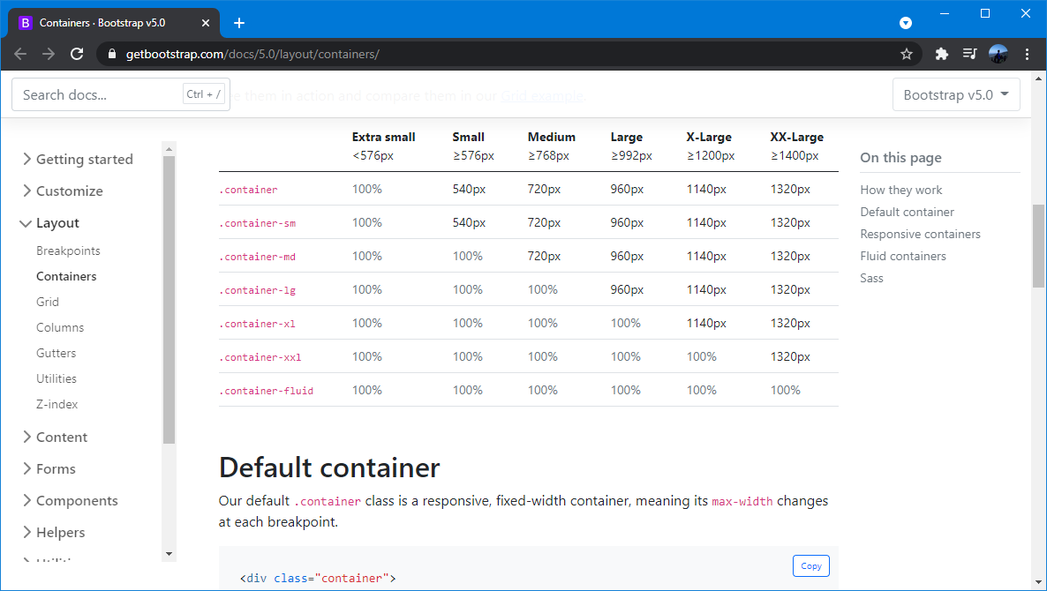
Please Check type of Bootstrap Containers
Link: https://getbootstrap.com/docs/5.0/layout/containers/

Slide 30
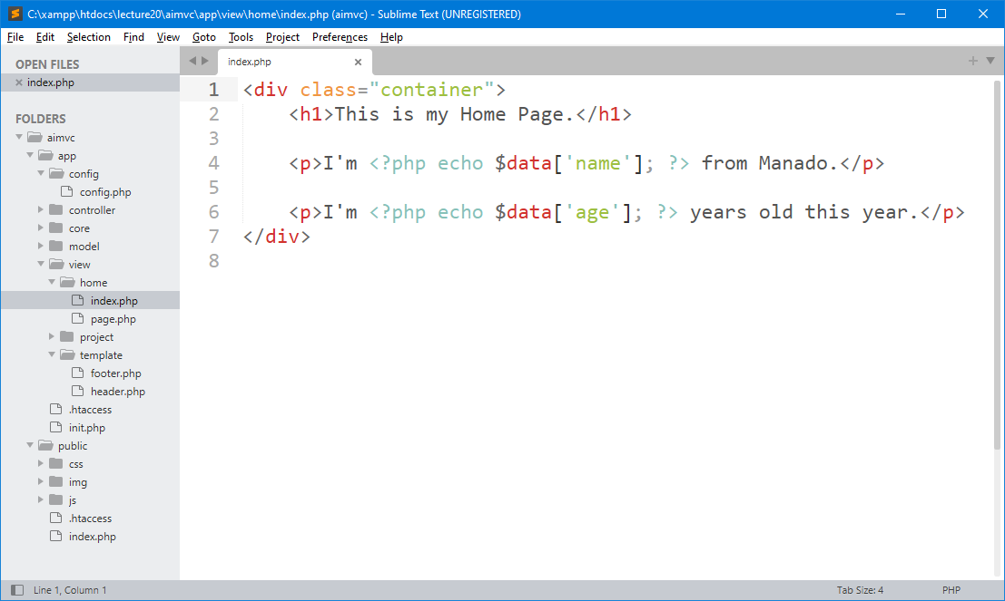
3 – Add Container in /view/home/index.php
The <div> tag defines a division or a section in an HTML document.

Slide 31
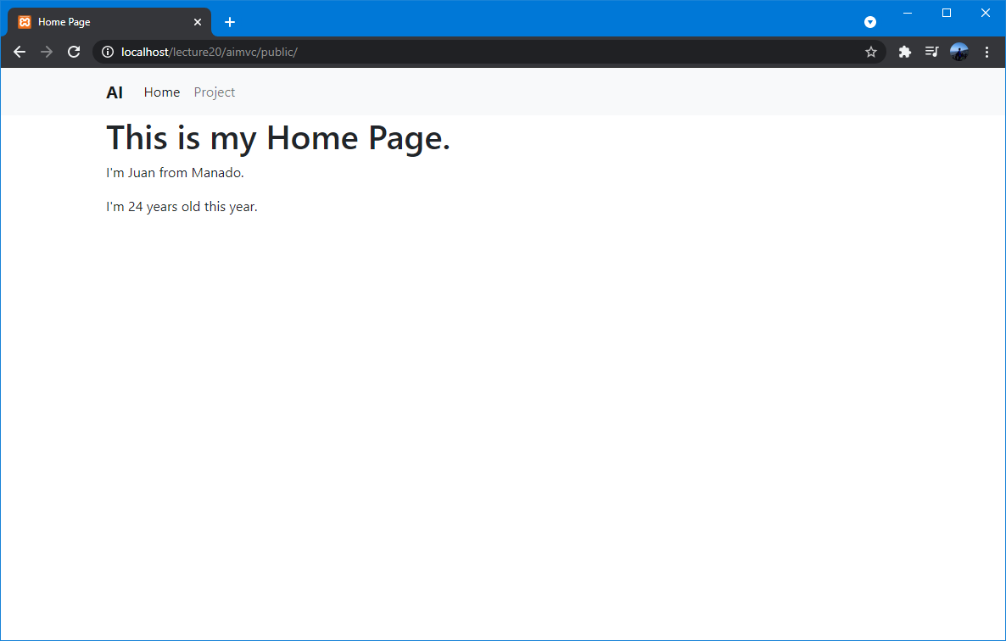
4 – Testing

Slide 32
5 – Create link in navigation header (Navbar)

Slide 33
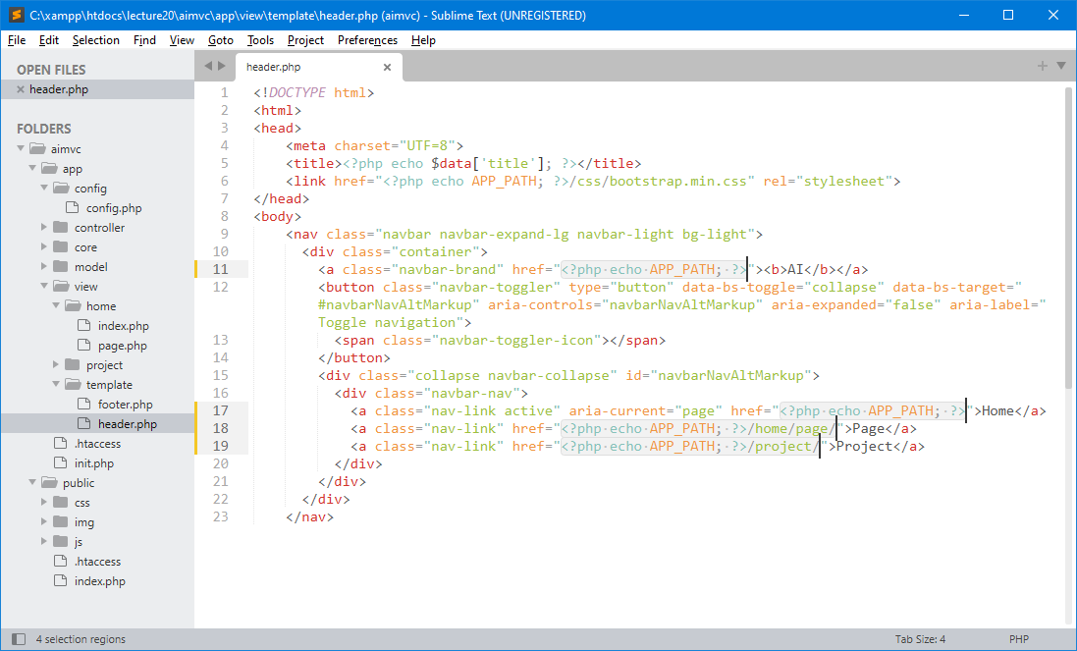
1 – All Link in Navbar

Slide 34
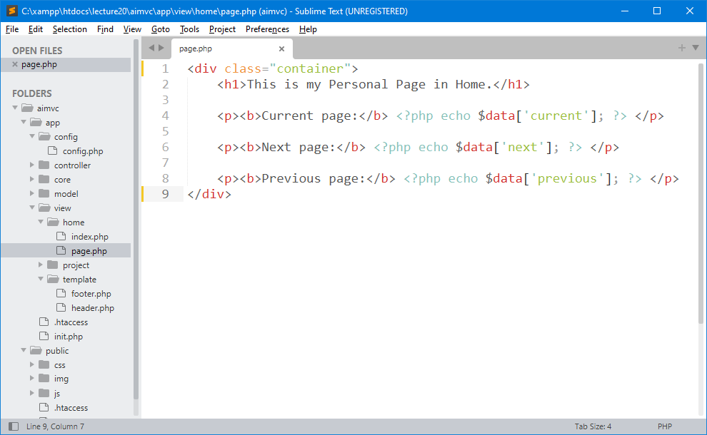
2 – Don’t forget add container in page.php file

Slide 35
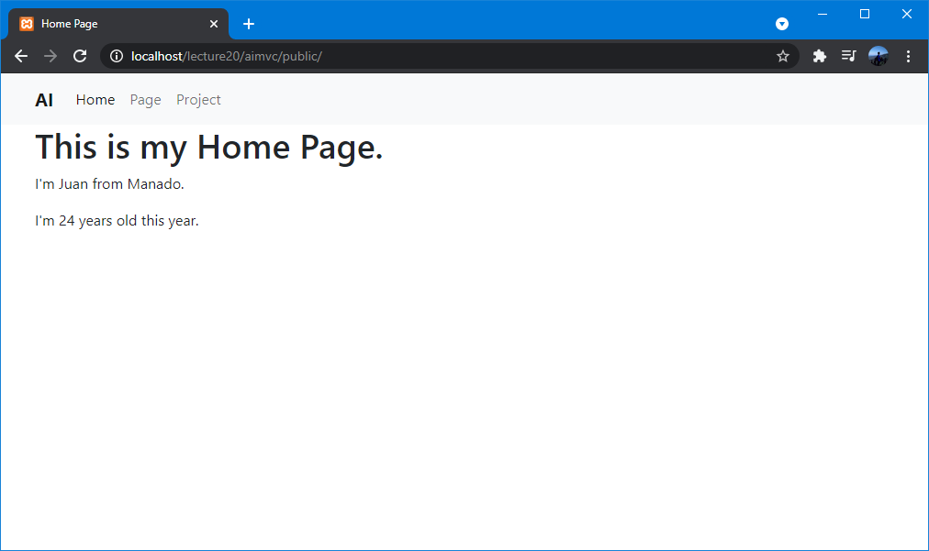
3 – Testing

Slide 36
5 – Add Image

Slide 37
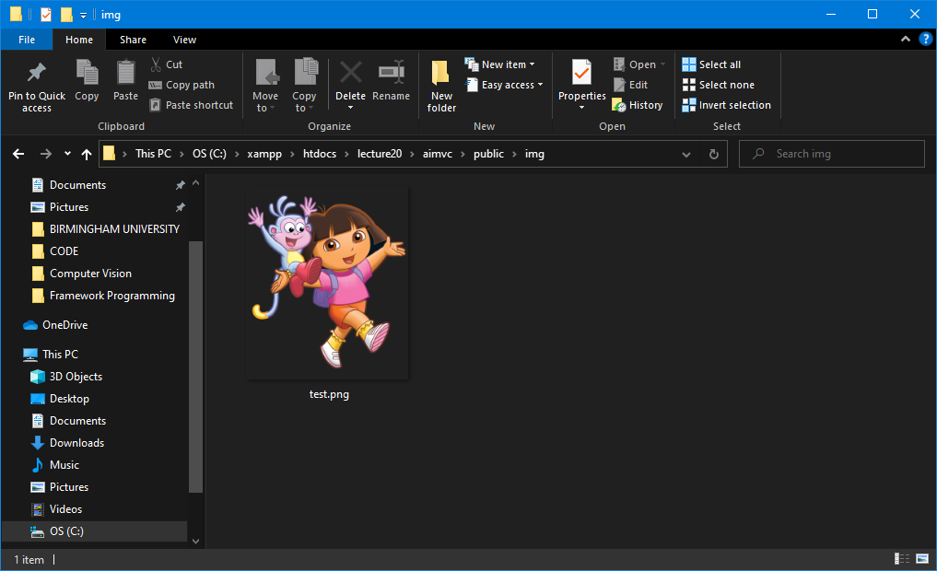
1 – Add an image in img directory

Slide 38
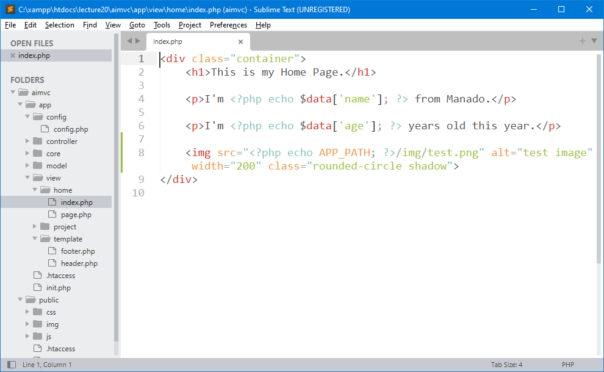
2 – Add img Tag in your Script

Slide 39
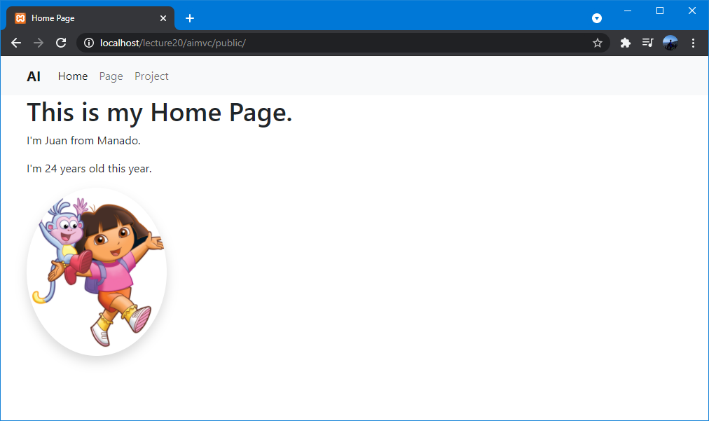
3 – Testing

Slide 40

Exercise for Students

Slide 41
Latihan untuk Students
Create directory : C:\xampp\htdocs\lecture20\
Create file : _.php
Buat semua contoh yang sudah di pelajari sebelumnya di lecture ini.

Slide 42

THANK YOU
END PRESENTATION
Thank you for your attention
Instructor: S – W – T

